Slide 1
Talent Program
.NET Track Week 2

Slide 2
Agenda
VS Overview ✓
Object oriented programing with C#
Part 1 ✓
Part 2 
Part 3
Database development in MS SQL Server
Software development process, tools and architecture
SPA with ASP.NET MVC
Unit testing

Slide 3
OOP with C#
Part 2 – Additional
Enumerations, array, collections, indexers, generics, attributes, exceptions, extensions, anonymous t&M
PART 3
LINQ to Objects

Slide 4

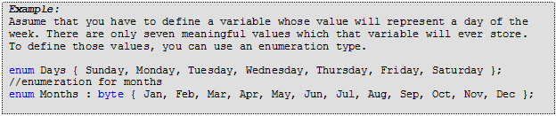
Enumerations
set of named integral constants
enum keyword
int underlying type
specify values or not (set most logical to 0)
use enumerations to define bit flags (!, &, I, ^, !)
Example (AbstractCar.cs)
advantages over using numbers

Slide 5
Arrays
data structure of elements of same type
single, multi dimensional or jagged (array of arrays)
zero indexed
reference types derive from Array class
Example (materials)

Slide 6
Collections
special types for data storage and retrieval
support for stacks, queues, lists and hash tables
part of System.Collections or System.Collections.Generic namespace
IEnumerable, ICollection, IList, IDictionary interfaces
IList – elements have only values
IDictionary- elements are key-value pairs
Example (CarPark)

Slide 7
LAB 06-10
Define classes
Define structures
Windows Forms Application (inheritance)
Interfaces and overriding
Static members

Slide 8
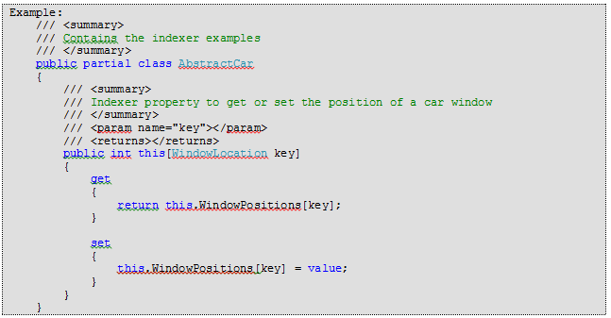
Indexers
ability to access values like an array
resemble properties but parameter(s)
used in types that encapsulate collection or array
this keyword

Slide 9
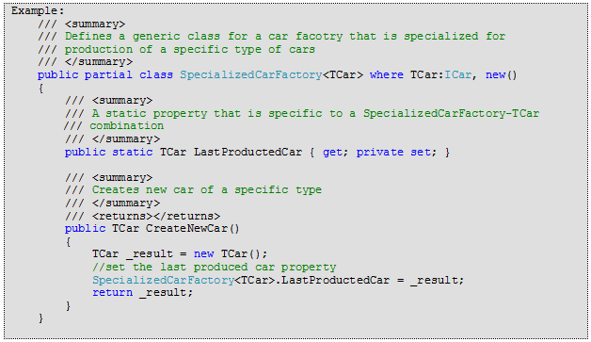
Generic classes and collections
Introduced in .NET 2.0
allow specifying type parameters (type safe)
Avoid casting to object (back and forward)
System.Collections.Generic namespace

Slide 10
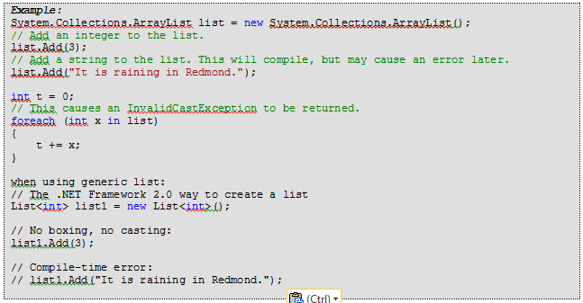
Generic classes and collections
comparison example
boxing/unboxing value types
CarPark generic example

Slide 11
Generic dictionary
Dictionary<Tkey, Tvalue>
one of the most used generic types
Key/Value in memory map
O(1) operation cost (when using key)
KeyValuePair<Tkey,Tvalue> for element iteration
Keys, Values property to access keys and values
Example (AbstractCar, CarPark)

Slide 12
Constraints on type parameters
Constraint | Description
where T: struct | The type argument must be a value type. Any value type except Nullable can be specified.
where T : class | The type argument must be a reference type; this applies also to any class, interface, delegate, or array type.
where T : new() | The type argument must have a public parameterless constructor. new() constraint must be specified last.

Slide 13
Constraints on type parameters
Constraint | Description
where T : <base class name> | The type argument must be or derive from the specified base class.
where T : <interface name> | The type argument must be or implement the specified interface. Multiple interface constraints can be specified. The constraining interface can also be generic.
where T : U | The type argument supplied for T must be or derive from the argument supplied for U.
Example (SpecializedCarFactory)

Slide 14
default keyword
Q:how to set the default value for a type?
- when int, default = 0
-when reference, default = null
-when Nullable, default = null
solution default keyword

Slide 15
Delegates and events
Want to execute some action but don’t know the method to call
Event-driven programming
Event encapsulates that something happened
Events and delegates are tightly coupled

Slide 16
Delegates
A reference type
References a method instead of an object
System.MulticastDelegate base class
Encapsulate a method
delegate keyword
decouple the class that uses from the one that declares
Example (SpecialiedCarFactory)

Slide 17
Events
publish – subscribe
publisher rises the event, does not care who is subscribed
decoupled by the delegate
Publisher- defines the delegate
Subcriber
Define a method (event handler)
Subscribe to the event
C# event handlers void (object sender, EventArgs arguments)
subscribe +=, unsubscribe -= (can use = as well, Difference?)
Example (SpecializedCarFactory)

Slide 18
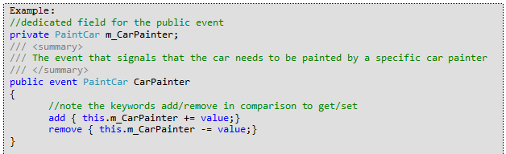
event keyword
allow only += and -=
notice add/remove

Slide 19
EventHandler delegate
delegate void EventHandler<T>(object sender, EventArgs<t> args)
You only define the EventArgs class
Example (SpecializedCarFactory.OnCarComplete)

Slide 20
Attributes
Add additional metadata for the elements
Idea is to annotate code using attributes
Inherit from System.Attribute
Attribute | Description
[CLSCompliantAttribute] | Enforces the annotated item to conform to the rules of the Common Language Specification (CLS). Recall that CLS-compliant types are guaranteed to be used seamlessly across all .NET programming languages.
[ObsoleteAttribute] | Marks a deprecated type or member. If other programmers attempt to use such an item, they will receive a compiler warning describing the error of their ways.
[SerializableAttribute] | Marks a class or structure as being “serializable,” meaning it is able to persist its current state into a stream.
[NonSerializedAttribute] | Specifies that a given field in a class or structure should not be persisted during the serialization process.
[DataContractAttribute] | Specifies that the type defines or implements a data contract and is serializable by a serializer, such as the DataContractSerializer.
[DataMemberAttribute] | When applied to the member of a type, specifies that the member is part of a data contract and is serializable by the DataContractSerializer.
[FlagsAttribute] | Indicates that an enumeration can be treated as a bit field; that is, a set of flags.

Slide 21
Attribute consumers,applying, custom
Different consumers (compiler ex:COM, serializer, formatter etc)
Apply it using brackets on assembly,class, method, property
Don’t need to specify Attribute when applying
Example (AbstractCar, AssemblyInfo.cs)
Define custom
Define usage (AttributeUsageAttribute ☺)
Example (VehicleMetadata)

Slide 22
Exceptions
With error codes (pre .NET)
.NET = structured exception handling
Define human readable message, call stack, throw/catch
Four elements in SHE
Exception class
Member that throws
Code that calls the error prone member
Code that handles the exception
Keywords – throw, try, catch, finally
Inherit from System.Exception

Slide 23
System.Exception class
System.Exception property | Description
Data | This read-only property retrieves a collection of key/value pairs(represented by an object implementing IDictionary) that provideadditional, programmer-defined information about the exception. By default, this collection is empty.
HelpLink | This property gets or sets a URL to a help file or web site describing the error in full detail.
InnerException | This read-only property can be used to obtain information about the previous exception(s) that caused the current exception to occur. The previous exception(s) are recorded by passing them into the constructor of the most current exception.
Message | This read-only property returns the textual description of a given error. The error message itself is set as a constructor parameter.
Source | This property gets or sets the name of the assembly, or the object, that threw the current exception.
StackTrace | This read-only property contains a string that identifies the sequence of calls that triggered the exception. As you might guess, this property is very useful during debugging or if you wish to dump the error to an external error log.
TargetSite | This read-only property returns a MethodBase object, which describes numerous details about the method that threw the exception (invoking ToString() will identify the method by name).

Slide 24
Throwing exceptions
Use throw keyword
Example (CarPark)
Catching exceptions (multiple)
Use try/catch block
Example (CatchingException.cs)
Use multiple catch blocks (start from the most specific)
Example (CatchingMultipleExceptions.cs)
Re throw exceptions
Try/catch/finally

Slide 25
Custom exceptions
System.SystemException
System.ApplicationException
Inherit from System.ApplicationException
Example (CarParkFullException)
Follow:
Is marked with the [System.Serializable] attribute
Defines a default constructor
Defines a constructor that sets the inherited Message property
Defines a constructor to handle “inner exceptions”
Defines a constructor to handle the serialization of your type

Slide 26
Extension methods
"add" methods to existing types without creating a new derived type
Static methods called by using instance syntax
this keyword in params
Example(CarExtensions)
System.Linq all extensions for IEnumerable for LINQ
Must specify the namespace (using)
Method definition with same name is stronger then extension

Slide 27
Lab 11-16

Slide 28
Initializers
Possible to initialize field/property values on creation time
Example (CarDealer)
Collection initializers let you initialize elements in collection
Collection initializers can include object initializers
Example (CarDealerRegister)

Slide 29
Implicitly typed variables
Possibility to avoid type specification
Use the var keyword
var is not variant type, but is determined by the compiler
Example (CarDealer.HandleNewCarCreated)
The var keyword may be used in the following contexts:
On local variables (variables declared at method scope) as shown in the previous example.
In a for initialization statement Example: for(var x = 1; x < 10; x++)
In a foreach initialization statement Example: foreach(var item in list){...}
In a using statement Example: using (var file = new StreamReader("C:\\myfile.txt")) {...}

Slide 30
Anonymous types
Encapsulate a set of read-only properties in a class
Must use var (restrictions apply)
Compiler creates the type in runtime
new + object initializer to define anonymous type
The type is determined by compiler
Property name must be used if expression is used
Example (Anonymous)
Note
Anonymous types contain one or more public read-only properties.
No other kinds of class members, such as methods or events, are valid.
The expression that is used to initialize a property cannot be null, an anonymous function, or a pointer type.

Slide 31
Anonymous functions
Anonymous methods-possibility to define inline code blocks
Lambda expressions-more expressive way to create anonymous methods
delegate (params) { method body; }
Example (CarPainterAnonymous)

Slide 32
Lambda expressions
Anonymous function, expressions or statement
anonymous methods or expression trees (LINQ)
=> operator (goes to)
(params, return type)=> expression or
(params, return type)=> {statements;}
Example(CarPainterLambda)
type inference (compiler determines the parameter type)

Slide 33
Expression lambdas
One expression
Use parameters and return result
(input parameters) => expression
parameters separated with comma (x, y) => x == y
Define types explicitly (int x, string s) => s.Length > x
Zero parameters () => SomeMethod()
Can create expression trees

Slide 34
Statement lambdas
(input parameters) => {statement;}
In practice no more then 2-3 statements
Can’t create expression trees
Example (CarPainterLambda)

Slide 35
LINQ
Language-Integrated Query (LINQ)
Strongly typed query
applied on different data sources
Extension methods in System.Linq namespace
LINQ-centric features:
1. Implicitly typed local variables
2. Object/collection initialization syntax
3. Lambda expressions
4. Extension methods
5. Anonymous types.

Slide 36
LINQ
LINQ operators
Operator | Meaning
from, in | Used to define the backbone for any LINQ expression, which allows you to extract a subset of data from a fitting container.
Where | Used to define a restriction for which items to extract from a container.
Select | Used to select a sequence from the container
orderby, ascending, descending | Allows the resulting subset to be ordered in ascending or descending order.
group, by | Yields a subset with data grouped by a specified value.
join, on, equals, into | Performs joins based on specified key. Remember, these “joins” do not need to have anything to do with data in a relational database.

Slide 37
LINQ to Objects
Datasource is in memory collection
Operates directly on IEnumerable without provider
Eliminates nested foreach
Example (LinqToObjectsExample)

Slide 38
LAB 17-21

Slide 39
Home work
Complete the labs and send them on mail.
(goce.kalamadevski@seavus.com)
Test (total score 100):
30% from labs
10% from attendance
60% from test
You pass with score >=60

